Slide 1
DevOps

Slide 2
Agenda
Why DevOps
What is DevOps
History
Agile and DevOps
Continuous Integration and Continuous Delivery
Why DevOps Fails?

Slide 3
Why DevOps?
Scenario 1:
“3 days after production move, server is exhibiting very high CPU load”
Is this a Software development issue or IT Operations?
Notes:
Performance

Slide 4
Why DevOps?
Scenario 2:
“There is an issue with the Build Server, Code is not building”
Is this a Software development issue or IT Operations?
Notes:
Configuration

Slide 5
Why DevOps?
Scenario 3:
“New Build on Staging Server; QA can no longer log in to the application”
Is this a Software development issue or IT Operations?
Notes:
Security

Slide 6
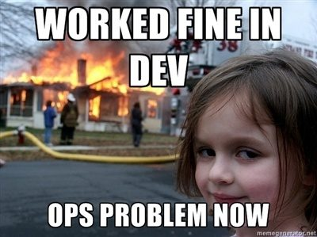
Why DevOps?
Notes:
Creates problems for business
Operability
Non-Functional requirements

Slide 7
Why DevOps?
Roles
Developer | IT Operation
Introduce Change | Provide Stability
Add/Modify features | Create/Enhance Services
Development is Agile | IT Operations is Static

Slide 8
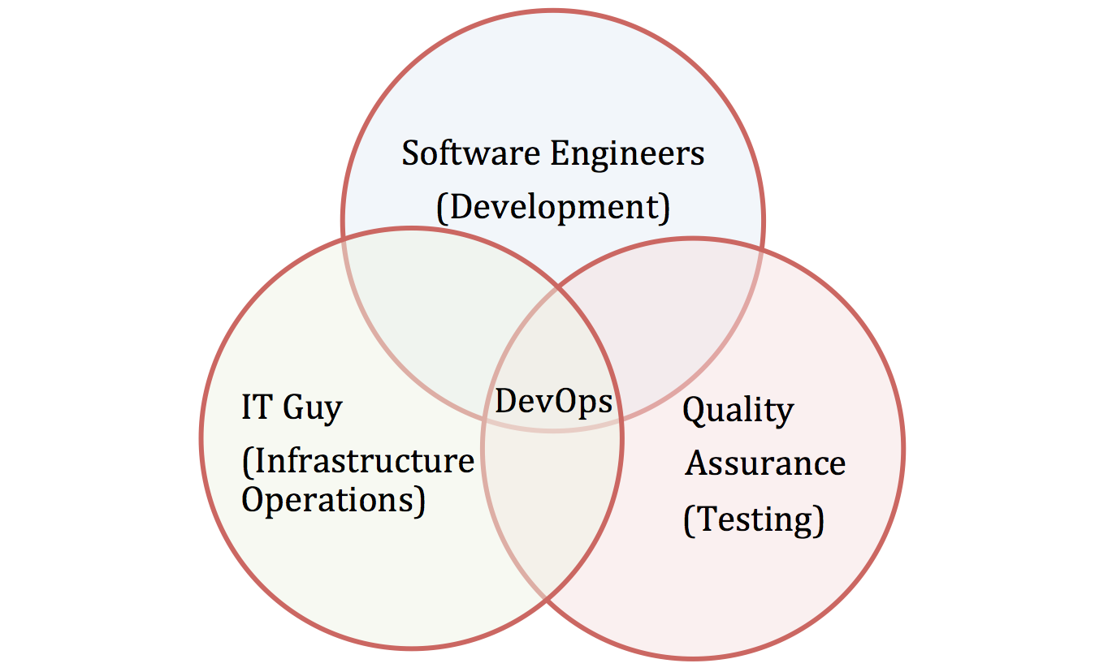
DevOps Role

Slide 9
What is DevOps?
“DevOps is the way in which a technology organization embeds itself in a business to the beneﬁt of that business.”
Notes:
On a high level - Business/Organization level
Profit = Revenue - Cost

Slide 10
What is DevOps?
DevOps is the practice of IT operations and development engineers participating together in the entire service lifecycle, from design through the development process to production support.
Software DEVelopment & IT OPerationS

Slide 11
History
Agile comes to the developer world in 2001
Lean comes to the developer world in 2003 (more slowly)
O’Reilly Radar “Operations: The New Secret Sauce” in 2006
Agile Infrastructure discussions start in Europe circa 2007
Patrick Debois and Andrew Schafer meet up at Agile 2008
O’Reilly Velocity Conference starts 2008
Patrick Debois and Kris Buytaert put together first “DevOpsDays” in Ghent in 2009. Many more follow.
2013 DevOps defined
Notes:
2008 - Agile System Administrator group

Slide 12
DevOps Principles
Gene Kim’s “3 ways”
Systems Thinking
Amplify Feedback Loops
Culture of Continual Experimentation
C.A.L.M.S.
Culture – People > Process > Tools
Automation – Infrastructure as Code
Lean - Small batch size and regular releases
Measurement – Measure Everything
Sharing – Collaboration/Feedback
Notes:
First way: Don’t think of isolated silos (dev/ops/support) but one system as whole (business value to the client)
3rd way: Feature Flags, A/B testing
IaaS - AWS

Slide 13
DevOps Practices
Version Control For All
Automated Testing
Proactive Monitoring and Metrics
Kanban/Scrum
Visible Ops/Change Management
Configuration Management
Incident Command System
Continuous Integration/Deployment/Delivery
Virtualization/Cloud/Containers
Toolchain Approach

Slide 14
Add Ops into Dev
Make Development Better With Ops
Production like environments
Power tooling (Infrastructure as code)
Enhance Service Design With Operational Knowledge
Reliability
Performance
Security
Build feedback paths back from Production
Monitoring
Metrics

Slide 15
Add Dev into Ops
Don’t do tasks for people. Build tools so they can do their own work.
Monitoring/logging/metrics feeds back into dev (and the business)
Developers work with Ops to understand the impact of code changes
Ops now have more clarity on infrastructure needs
Developers and Operations work together to provide production support
Notes:
Developers now work more closely with production-equivalent systems
Developers focuses on metrics required by Ops team like PSR
Ops now have more clarity on infrastructure needs
More automation on deployment
Closely monitors the Dev – Test – Prod pipeline foreach deployment with immediate feedback
Better collaboration and communication

Slide 16
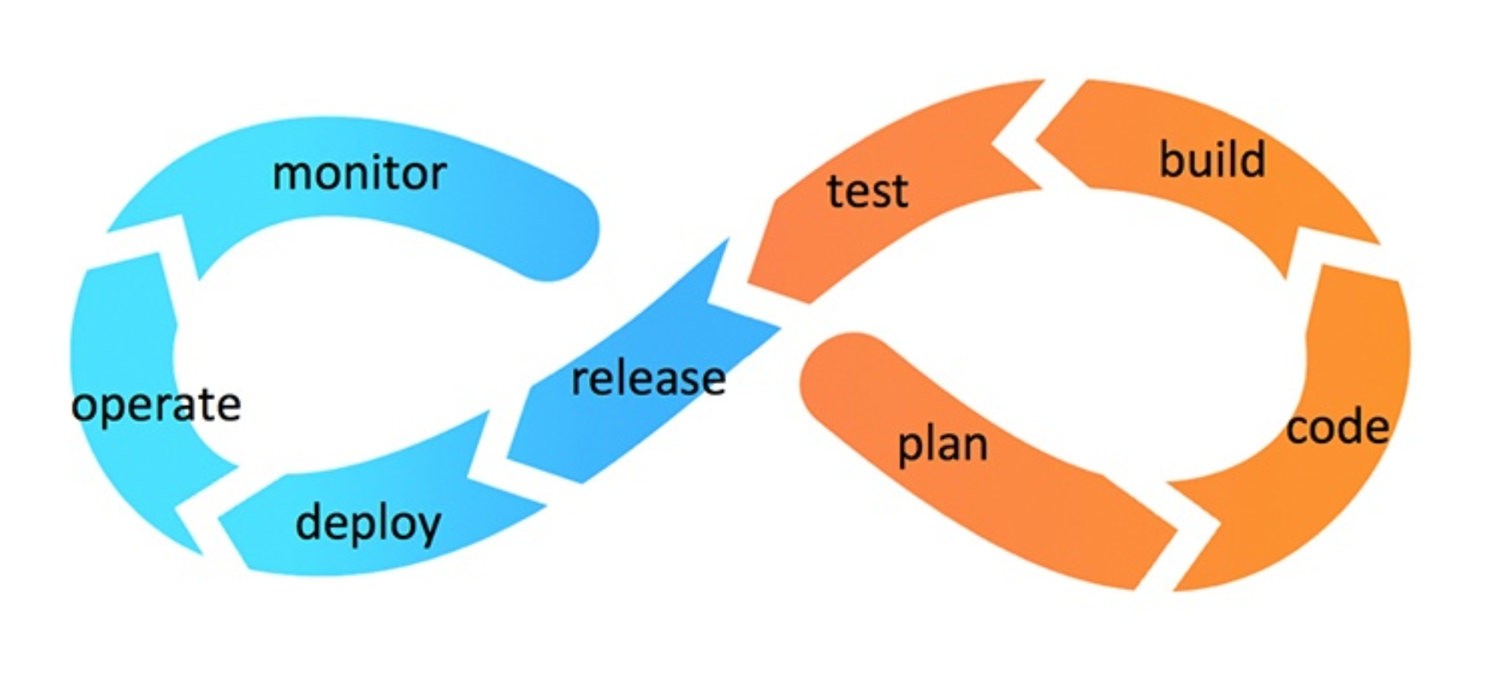
Continuous Feedback Loop

Slide 17
Agile and DevOps
Agile Development
Addresses the gap between customer requirements and dev + testing
Cross-functional teams to design, develop, and test features/stories
Continuous Development + Testing
Focuses more on functional and non-functional readiness
DevOps
Addresses the gap between dev + testing and Ops
Automated release management
Focuses on functional and nonfunctional plus operational and business readiness
Continuous Integration and Deployment is required

Slide 18
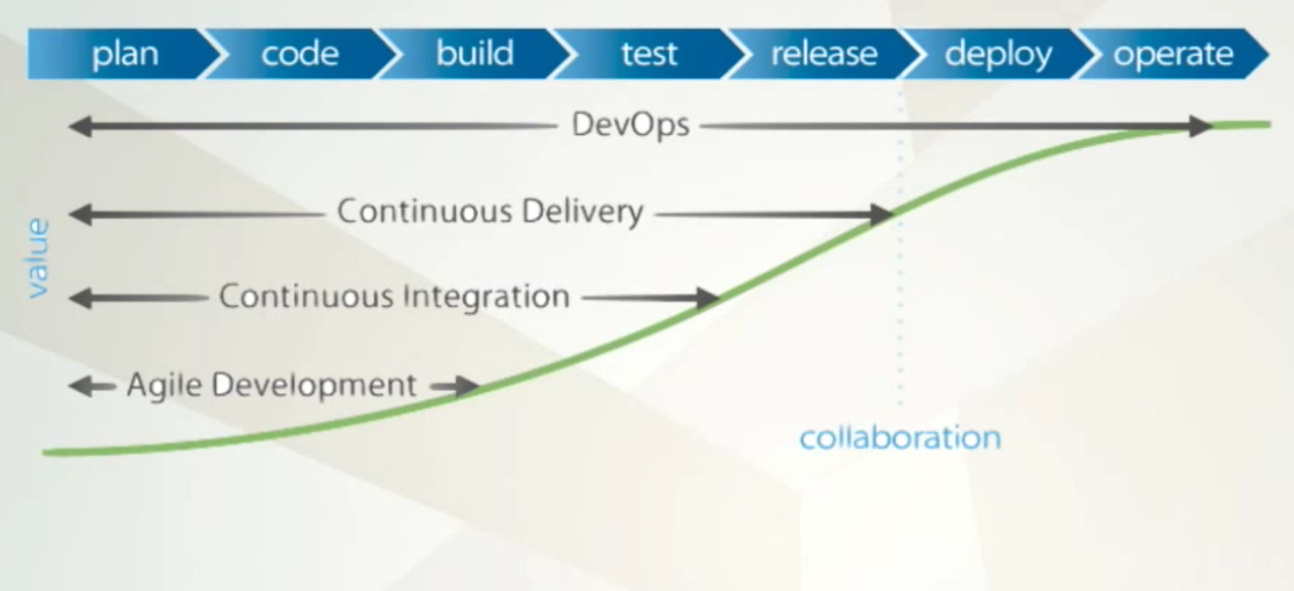
DevOps
Notes:
Business value
Lower cost
Fail Fast
Deliver Value in quick and small burst
Collaboration across teams
Full pipeline Automation

Slide 19
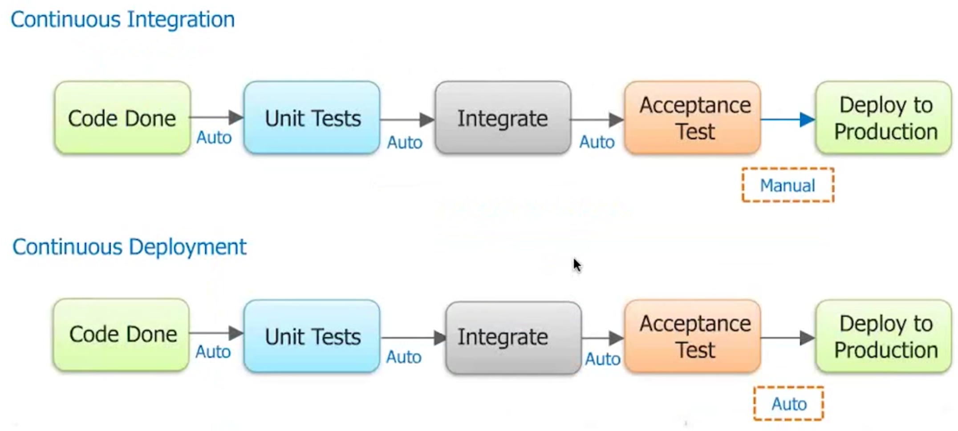
CI / CD

Slide 20
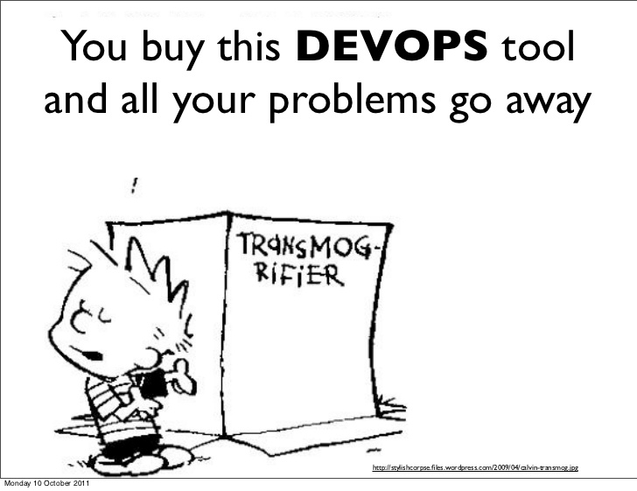
CI / CD
Automation Tools
Notes:
Is this a tool?

Slide 21
CI / CD
Automation Tools
Infrastructure Automation | Puppet, Chef,Vagrant
Configuration Management | Ansible, Chef, Capistrano
Continuous Integration | Git, Jenkins, Hudson, Ant, Maven
Continuous Deployment | Jenkins, Custom Tools
Monitoring | Nagios, Icinga, Custom Tools
Notes:
Technology enables new business models and new DevOps models. Tools are simply an expression of those models.

Slide 22
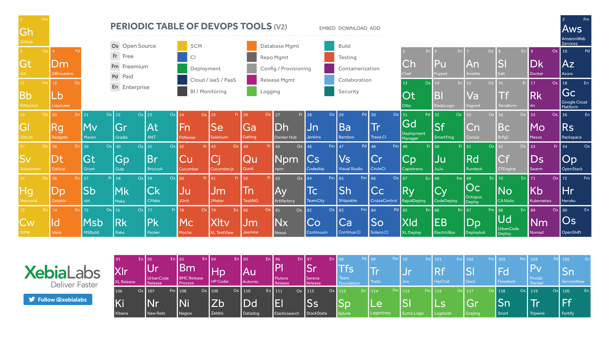
DevOps

Slide 23
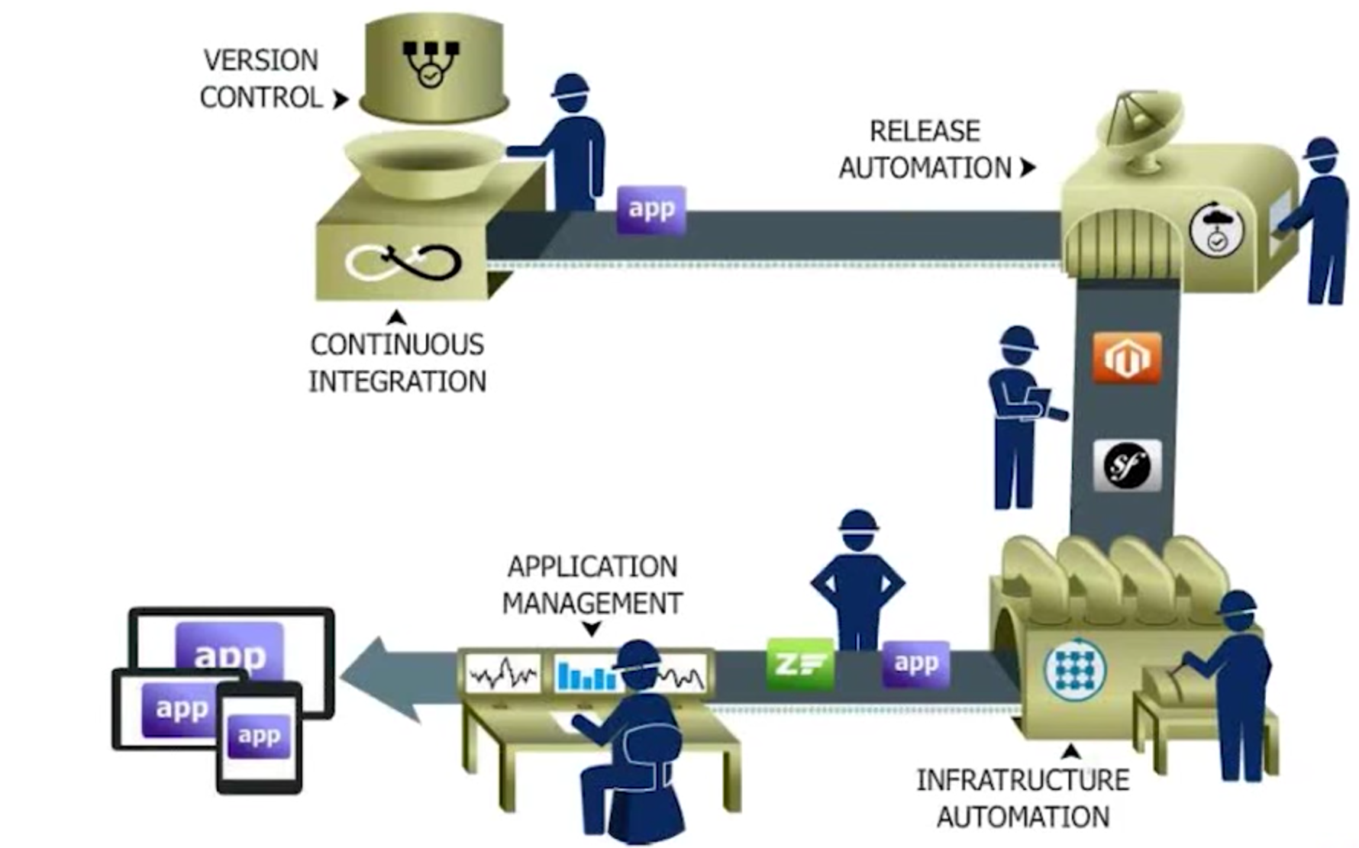
Continuous Delivery

Slide 24
Continuous Delivery
The process for releasing/deploying software MUST be repeatable and reliable
Automate everything!
Keep everything in source control
Build quality in!
Everybody has responsibility for the release process
Improve continuously
Notes:
Continuous Delivery + Operability
Operability = Scalability, Deployability, Maintainability, Security, Resilience, Monitoring, Alerting, DR

Slide 25
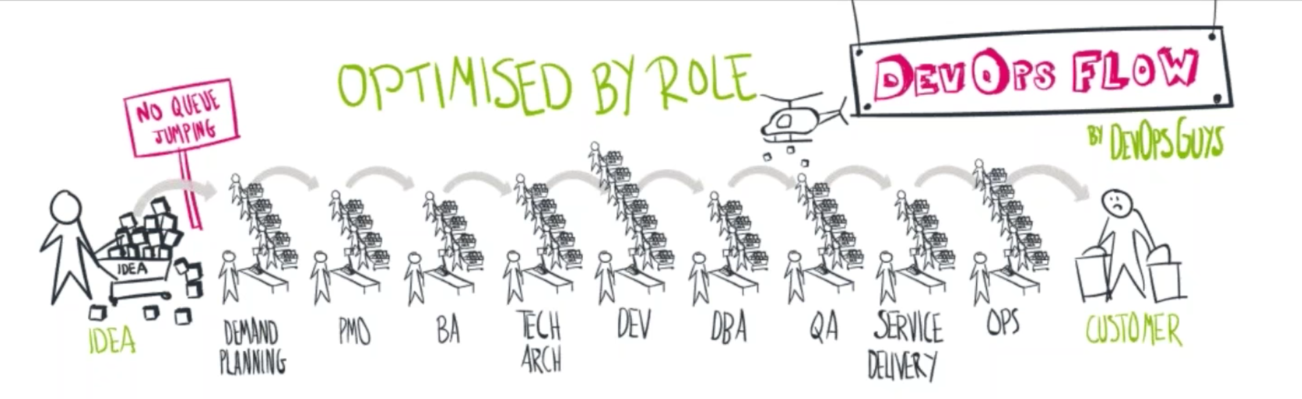
DevOps Topologies - Traditional

Slide 26
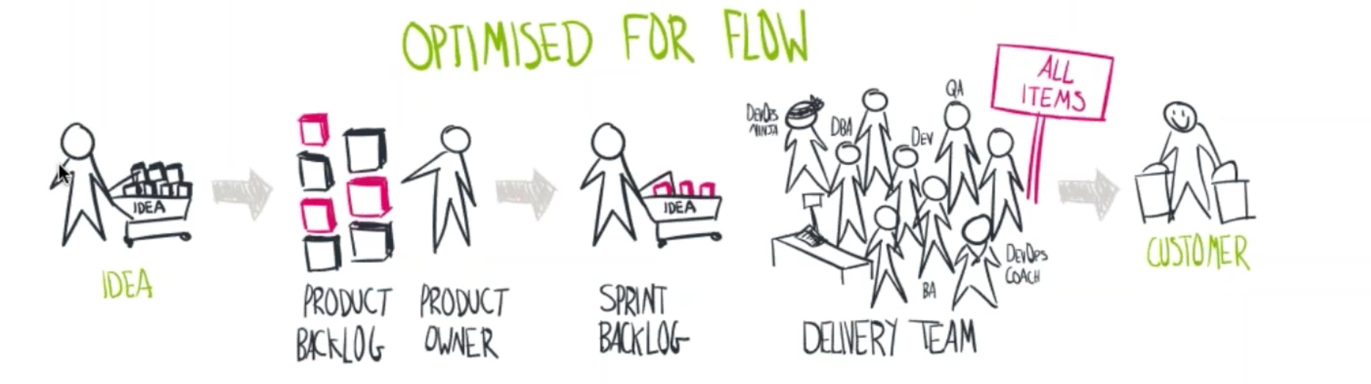
DevOps Topologies

Slide 27
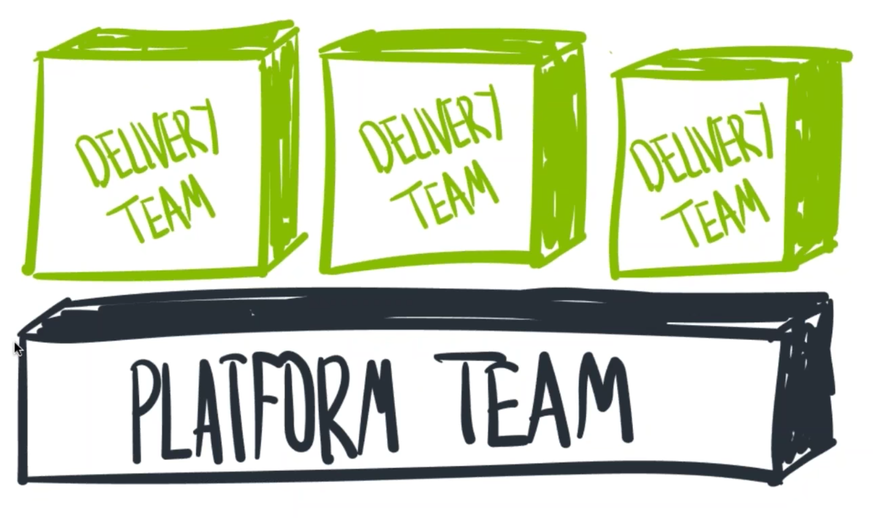
DevOps Topologies
Notes:
A big platform team that supports delivery teams.
Conveyor belts system
Platform as a service (Google internal)

Slide 28
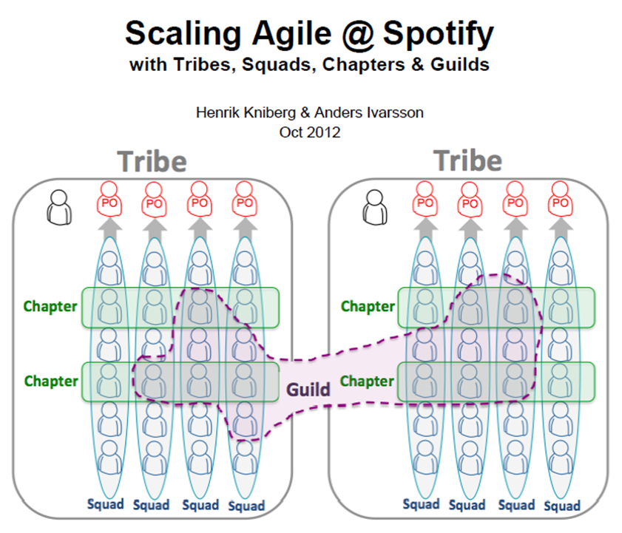
DevOps Topologies - Spotify
Notes:
Autonomous delivery team
You build it, you run it.

Slide 29
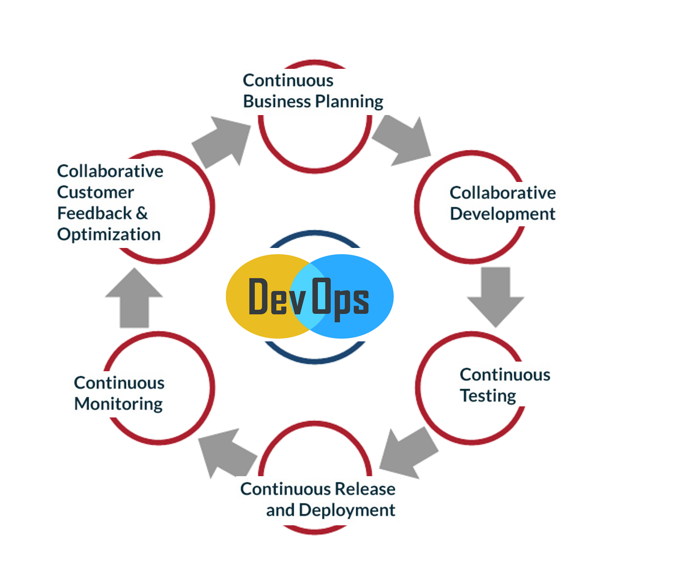
DevOps Topologies
Notes:
In conclusion for Topologies
Game Days (Planned Chaos, test resilience)
DevSecOps
BizDevOps (digital transformation)

Slide 30
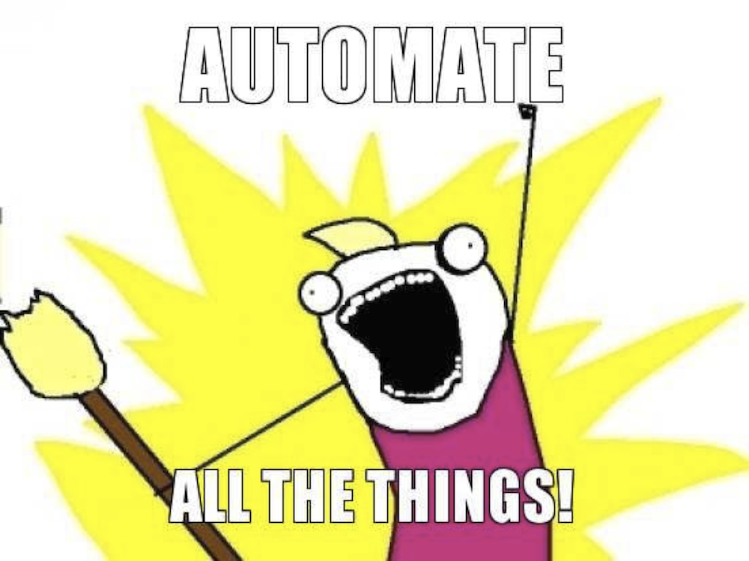
As an Organization
Notes:
What should we do?

Slide 31
As an Organization
Establish your goals
What does DevOps mean to your business?
Build the platform
Environments
Continuous Integration
Continuous Delivery
Build the Team
Follow Agile process
Empower the team
Autonomy, purpose, mastery and goals
Notes:
Culture will change indirectly.
Technology enables new business models and new DevOps models. Tools are simply an expression of those models.

Slide 32
Why DevOps Fails?
No Trust
Bottlenecks in Cross Functional Teams
Not failing fast (Agile)
DevOps team not empowered (just the team title)
Creating a new silo
DevOps with incomplete Automation/ Incorrect Tools
Notes:
It takes time and resources to implement the automated pipeline
Technology enables new business models and new DevOps models. Tools are simply an expression of those models.

Slide 33
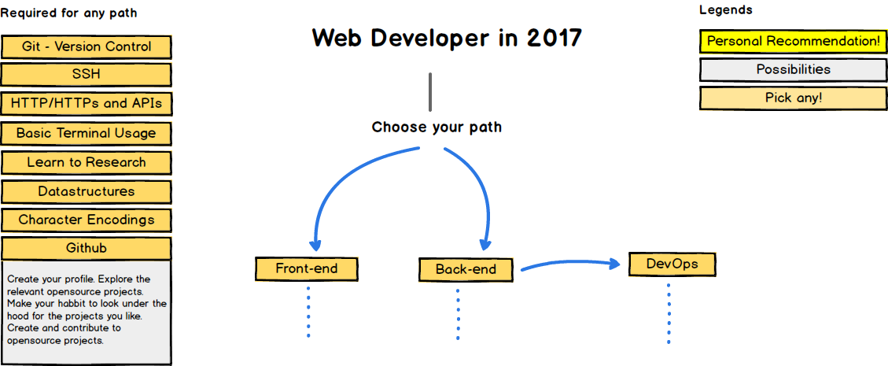
Roadmap to becoming a web developer - 2017

Slide 34
Core DevOps Research List
Gene Kim’s Visible Ops
Tom Limoncelli’s The Practice Of Cloud System Administration
Gene Kim’s The Phoenix Project (modeled on Goldratt’s The Goal)
Jez Humble’s Continuous Delivery
Michael Nygard’s Release It!
Gene Kim’s The DevOps Cookbook
Various Mary and Tom Poppendieck Lean Software Development Books
Velocity Conference (velocityconf.com)
DevOpsDays Unconferences – There’s one near you! (devopsdays.org)
DevOps Weekly newsletter (devopsweekly.com)
DevOps Café Podcast (devopscafe.com)
The Twelve Factor App (12factor.net)
The Agile Admin (theagileadmin.com)
Notes:
Monolith vs microservice

Slide 35
DevOps
Questions?

Slide 36
CI / CD for Node.js
https://strongloop.com/strongblog/roll-your-own-node-js-ci-server-with-jenkins-part-1/
https://strongloop.com/strongblog/roll-your-own-node-js-ci-server-with-jenkins-part-2/
Notes:
Strider
Travis
Jenkins

Slide 37
What’s next?
NoOps
IT environment can become so automated and abstracted from the underlying infrastructure that there is no need for a dedicated IT Ops team
Notes:
AWS Lambda - Nov 2014
Google Functions - Feb 2016
Azure Functions - March 31 2016

